Slide 1
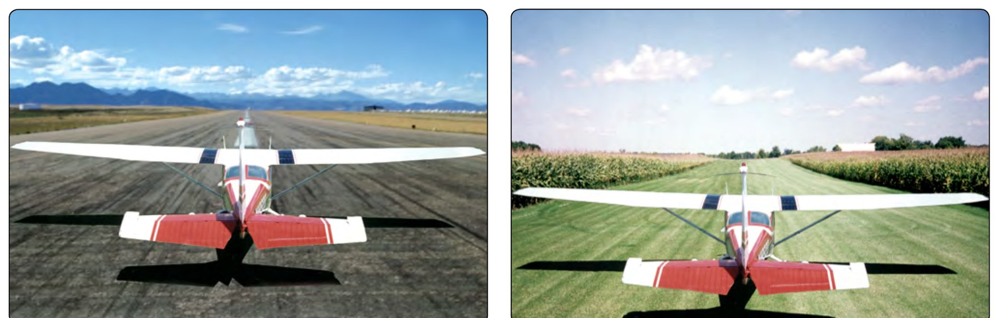
AI.II.F
Performance and Limitations
Area II: Technical Subject Areas
ACS Task II.F (AI.II.F)
Cessna 172S NAV III (G1000)
[Name], CFI Applicant
PHAK Fig 11-16
Notes:
Today we learn how to predict what the airplane will do before we fly it, and how to load it so it stays inside its limits. Everything we use comes from the POH, the TCDS, and the FAA handbooks.

Slide 2
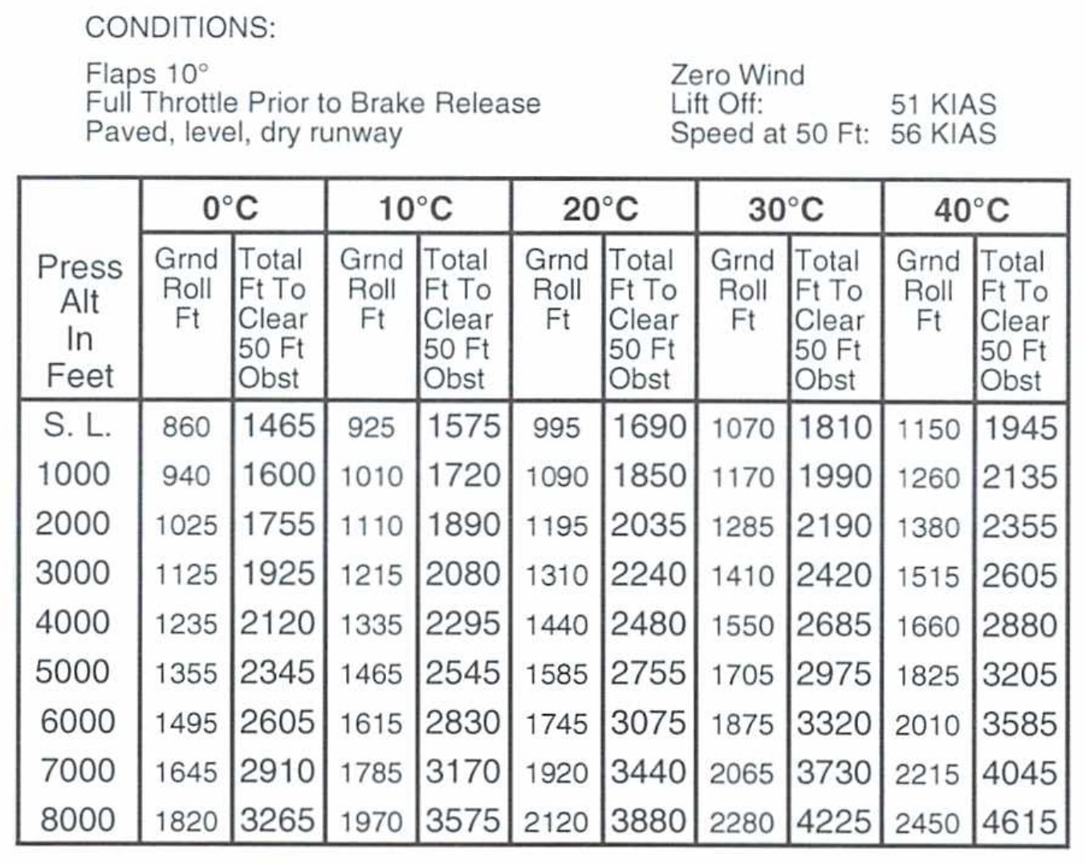
AI.II.F
Objective
Read POH performance charts
Explain what changes performance
Compute weight and CG
Fix loading that is out of limits
ACS II.F, POH Fig 5-5
Notes:
By the end you will be able to use the C172S charts to get real numbers, compute weight and balance, fix a bad CG, and explain the risks of skipping these steps.

Slide 3
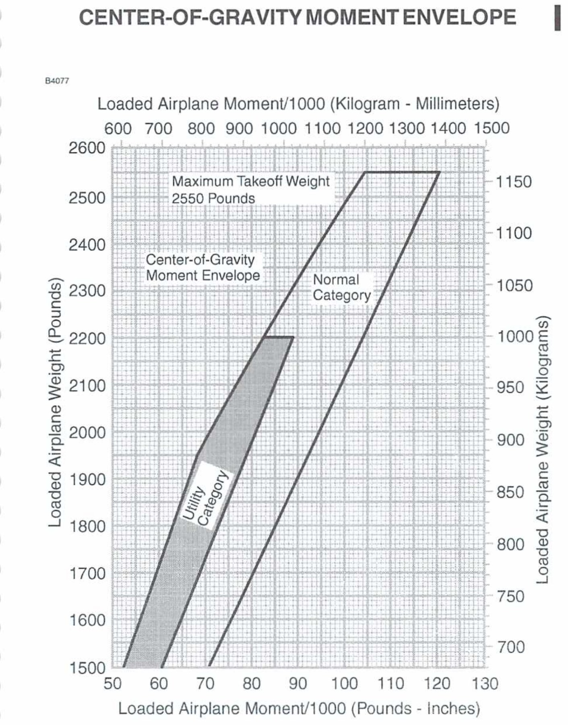
AI.II.F
Lesson Overview
Performance charts and factors
Weight and balance terms
C172S worked examples
Risk management
POH Fig 6-7
Notes:
Four parts. First the charts and what changes performance. Then the weight and balance words. Then real C172S problems. Last, the risks.

Slide 4
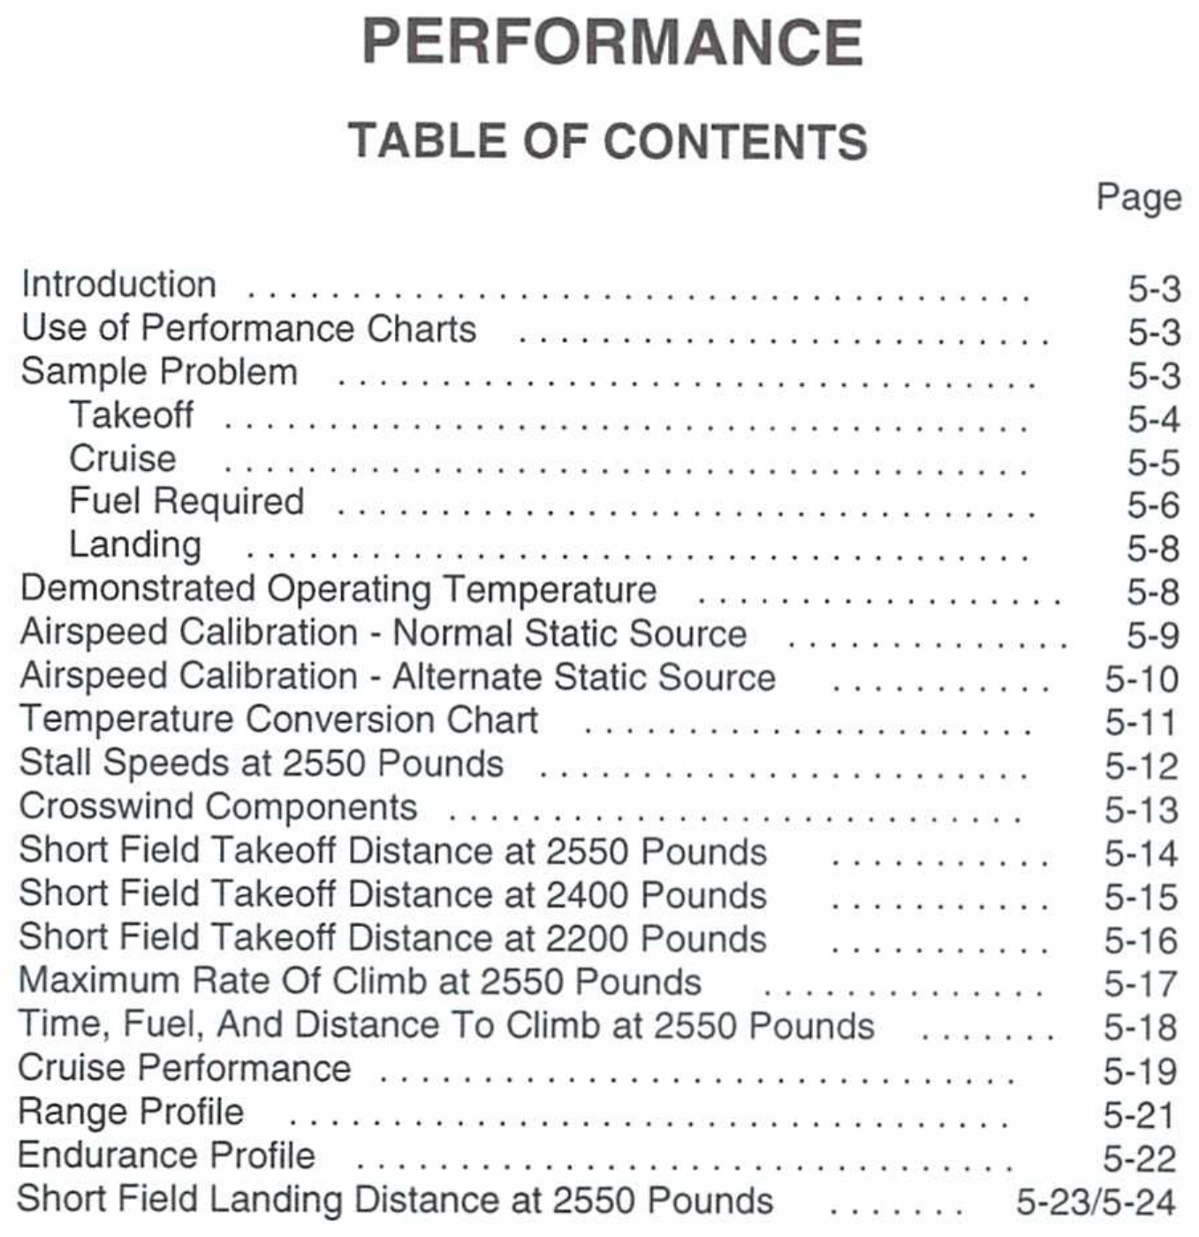
AI.II.F.K1
Where the Numbers Live
POH Section 2: limitations
POH Section 5: performance
POH Section 6: weight and balance
TCDS: certified limits
PHAK 11-1, PHAK 10-3, POH 5-1
Notes:
Performance data lives in Section 5 of the POH. Limits are in Section 2. Weight and balance is Section 6. The TCDS and the POH both publish the CG limits.

Slide 5
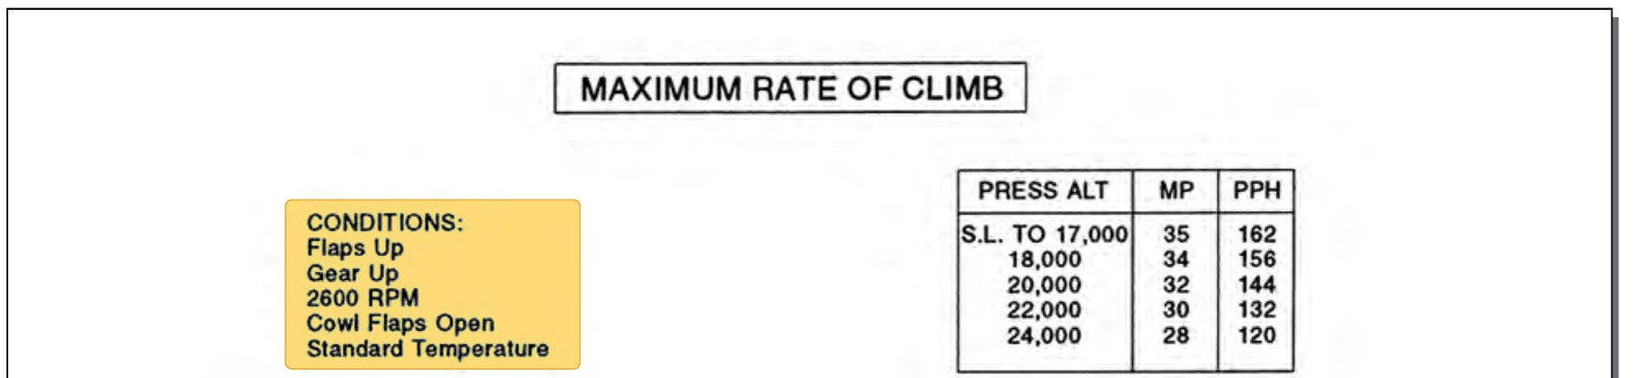
AI.II.F.K1
How the Charts Are Made
Flight tests in a new airplane
Average piloting skill
Airplane in good working order
Always read the conditions
PHAK 11-19, POH 5-3, PHAK Fig 11-20
Notes:
The numbers came from test flights in a new airplane flown with average skill. Our rental airplane is not new. Every chart lists the conditions it assumes, so read those first.

Slide 6
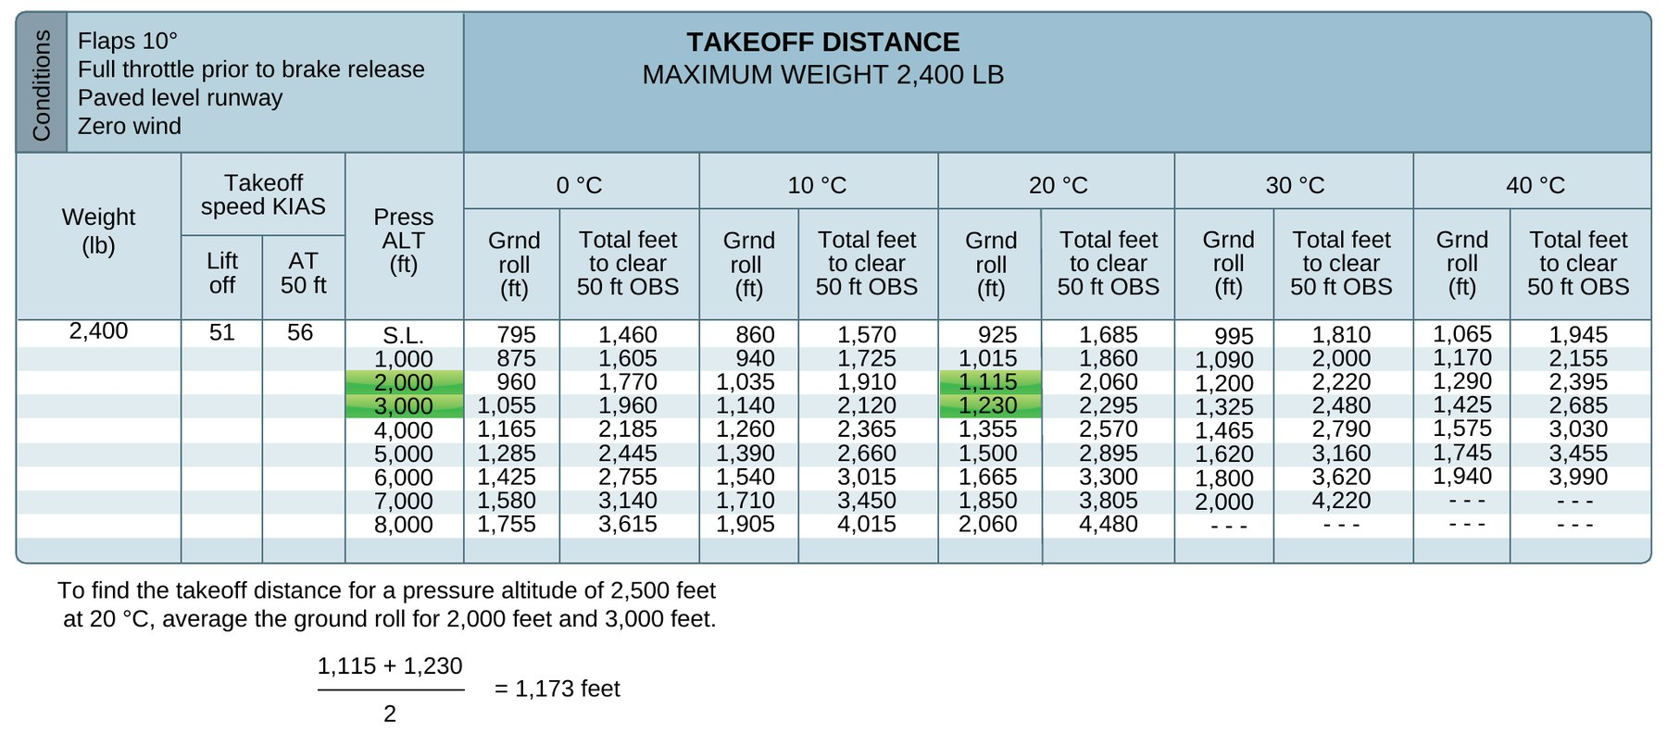
AI.II.F.K1
Reading Tables and Interpolating
Find your row and column
Interpolate between values
Or use next higher value
Higher value: more margin
PHAK 11-20, POH 5-4, PHAK Fig 11-21
Notes:
If our numbers fall between two rows, we can average them. That is interpolation. The POH also allows reading at the next higher weight, altitude, and temperature for a conservative answer.

Slide 7
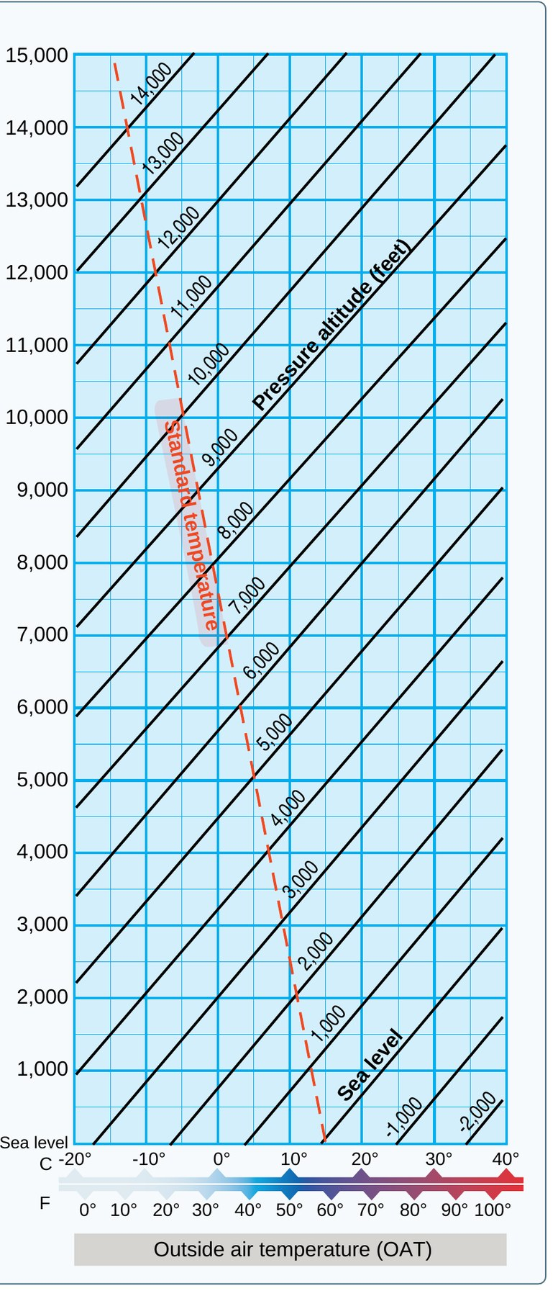
AI.II.F.K2a
Definition: Density Altitude
Density altitude
“the altitude in the standard atmosphere corresponding to a particular value of air density.”
Also stated as
“Density altitude is pressure altitude corrected for nonstandard temperature.”
PHAK 11-3, PHAK Fig 11-4
Notes:
Read both definitions word for word. The airplane does not care what the altimeter says. It performs based on how thick the air is, and density altitude tells us that.

Slide 8
AI.II.F.K2a
Density Altitude in Plain Words
Hot, high, humid: thin air
Less power, thrust, and lift
Longer runs, weaker climbs
Chart: hotter column, bigger number
PHAK 11-2, PHAK 11-5, POH Fig 5-5
Notes:
Thin air means the engine breathes less, the prop bites less, and the wing lifts less. Look at the chart: same altitude, hotter column, longer distance.

Slide 9
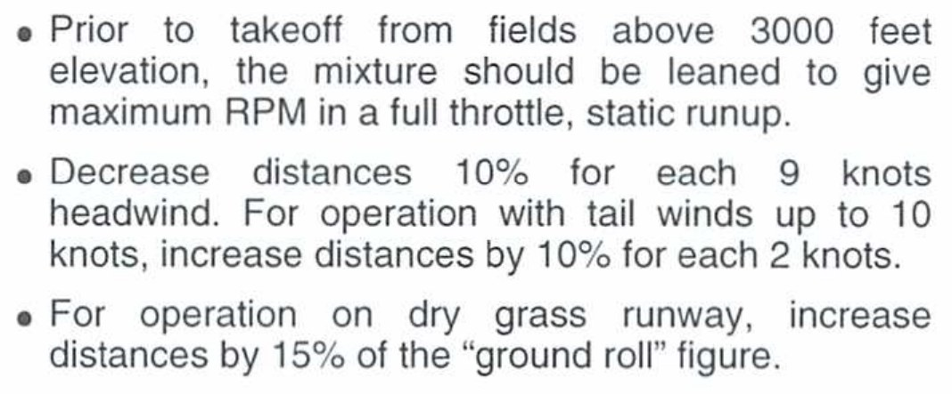
AI.II.F.K2b
Pilot Technique
Charts assume average technique
Use the chart's exact speeds
Short field technique: Section 4
Weak technique: add margin
POH 5-3, POH Fig 5-5, PHAK 11-15, PHAK 11-19
Notes:
The numbers only work if we fly the way the chart assumes. The C172S takeoff chart says short field technique per Section 4, lift off at 51 KIAS, 56 KIAS at 50 feet.

Slide 10
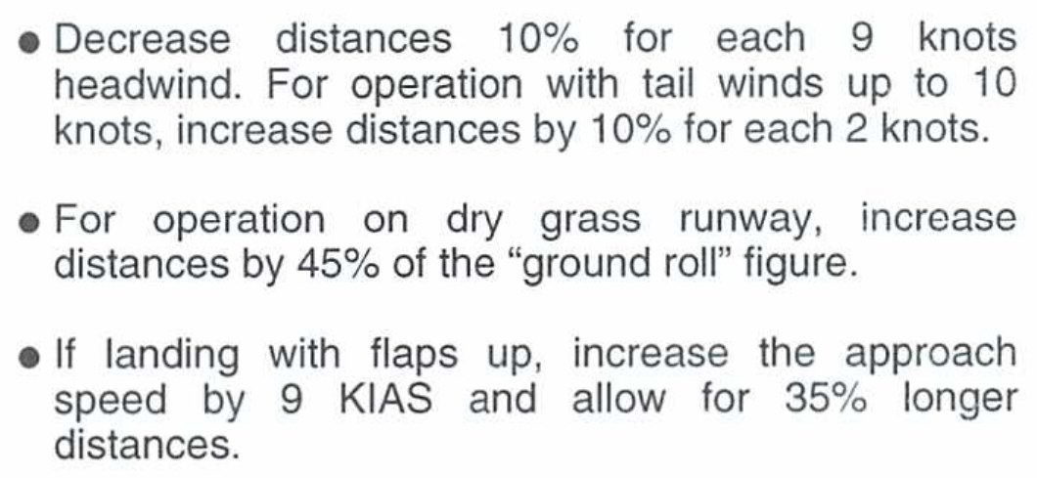
AI.II.F.K2c
Airplane Configuration
Takeoff chart: flaps 10 degrees
Climb chart: flaps up
Flaps up landing: 35% longer
Match the chart setup
POH Fig 5-5, POH Fig 5-7, POH Fig 5-11, PHAK 11-8
Notes:
Each chart is built for one configuration. The landing note says if you land with flaps up, add 9 knots to the approach speed and allow 35 percent more distance.

Slide 11
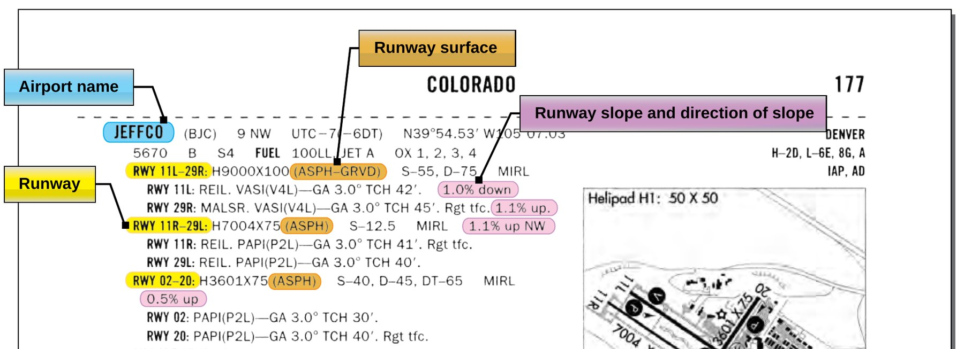
AI.II.F.K2d
Airport Environment: Surface and Slope
Charts assume paved, level, dry
Grass takeoff: +15% ground roll
Upslope: longer takeoff roll
Check the Chart Supplement
PHAK 11-12, PHAK 11-13, POH Fig 5-5, POH Fig 5-11, PHAK Fig 11-17
Notes:
The chart assumes a perfect runway. Grass, mud, slope, and water all change the answer. The Chart Supplement tells us surface and slope.

Slide 12
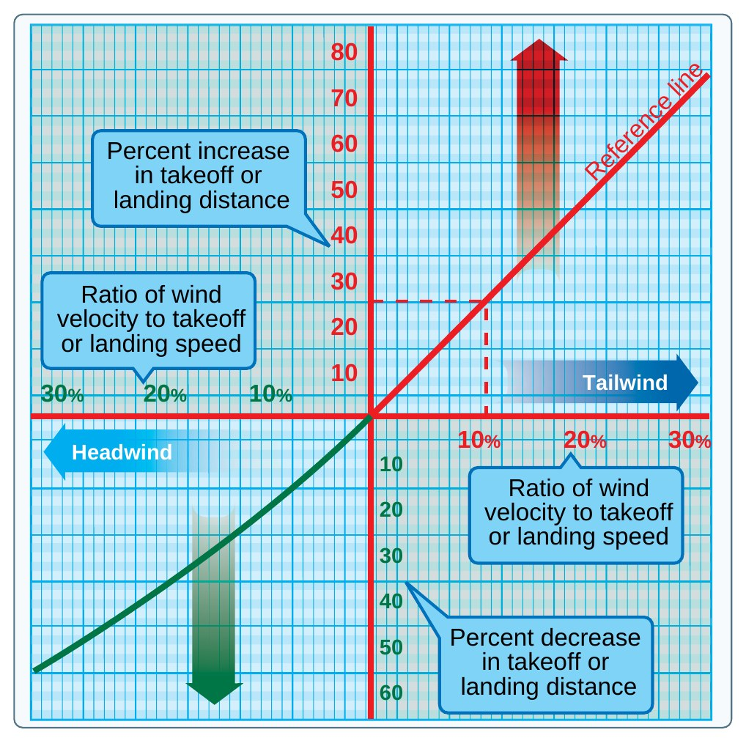
AI.II.F.K2d
Airport Environment: Wind
Headwind shortens distances
Tailwind lengthens them more
C172S: minus 10% per 9 kt
Tailwind: plus 10% per 2 kt
PHAK 11-15, POH Fig 5-5, PHAK Fig 11-19
Notes:
A headwind gets us to flying speed sooner over the ground. A tailwind makes us run farther. Notice the tailwind correction is much bigger.

Slide 13
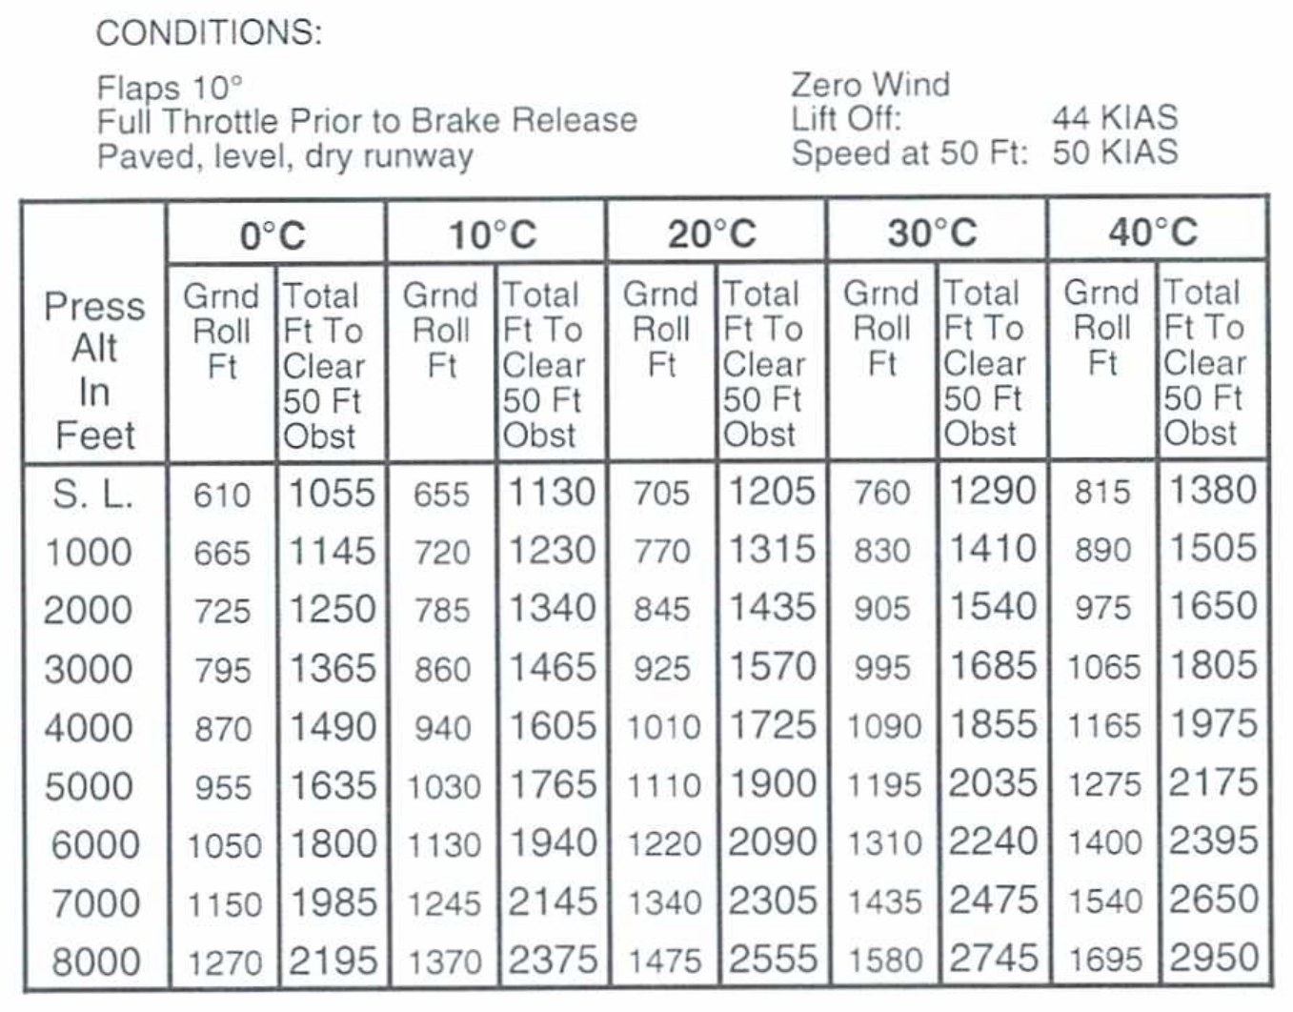
AI.II.F.K2e
Loading and Weight
Higher lift-off speed
More mass to accelerate
More drag and friction
Lighter airplane: shorter runs
PHAK 11-15, PHAK 10-2, POH 5-14, POH 5-16
Notes:
More weight hurts takeoff three ways. Compare the 2,550 lb chart to this 2,200 lb chart. Same conditions, shorter distances when lighter.

Slide 14
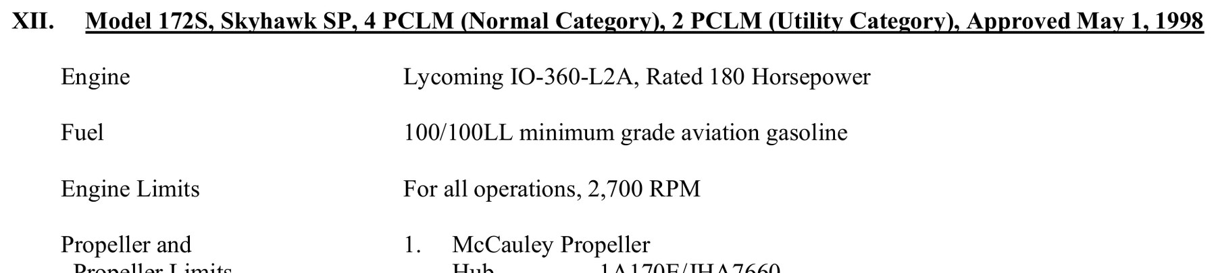
AI.II.F.K3, AI.II.F.R2
The Type Certificate Data Sheet
Part of the type certificate
Lists certified limits
C172S: TCDS 3A12
Engine, speeds, CG, weights
TCDS 3A12 p1, TCDS 3A12 p30, PHAK 10-3
Notes:
The TCDS is the FAA document that goes with the type certificate. For the 172S it lists the engine, airspeed limits, CG range, datum, and maximum weights.

Slide 15
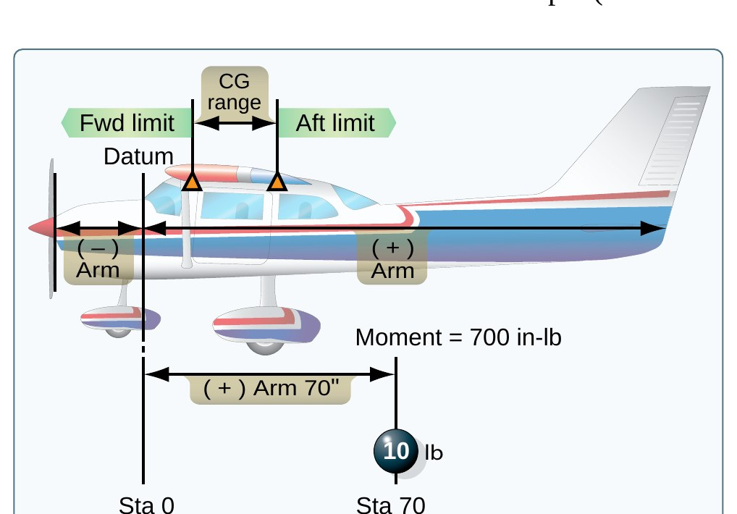
AI.II.F.K3
Definitions: Datum and Arm
Datum (reference datum)
“an imaginary vertical plane or line from which all measurements of arm are taken. The datum is established by the manufacturer. Once the datum has been selected, all moment arms and the location of CG range are measured from this point.”
Arm (moment arm)
“the horizontal distance in inches from the reference datum line to the CG of an item. The algebraic sign is plus (+) if measured aft of the datum and minus (−) if measured forward of the datum.”
PHAK 10-4, PHAK 10-5, PHAK Fig 10-2
Notes:
Read both definitions word for word, then go to the next slide for the plain words.

Slide 16
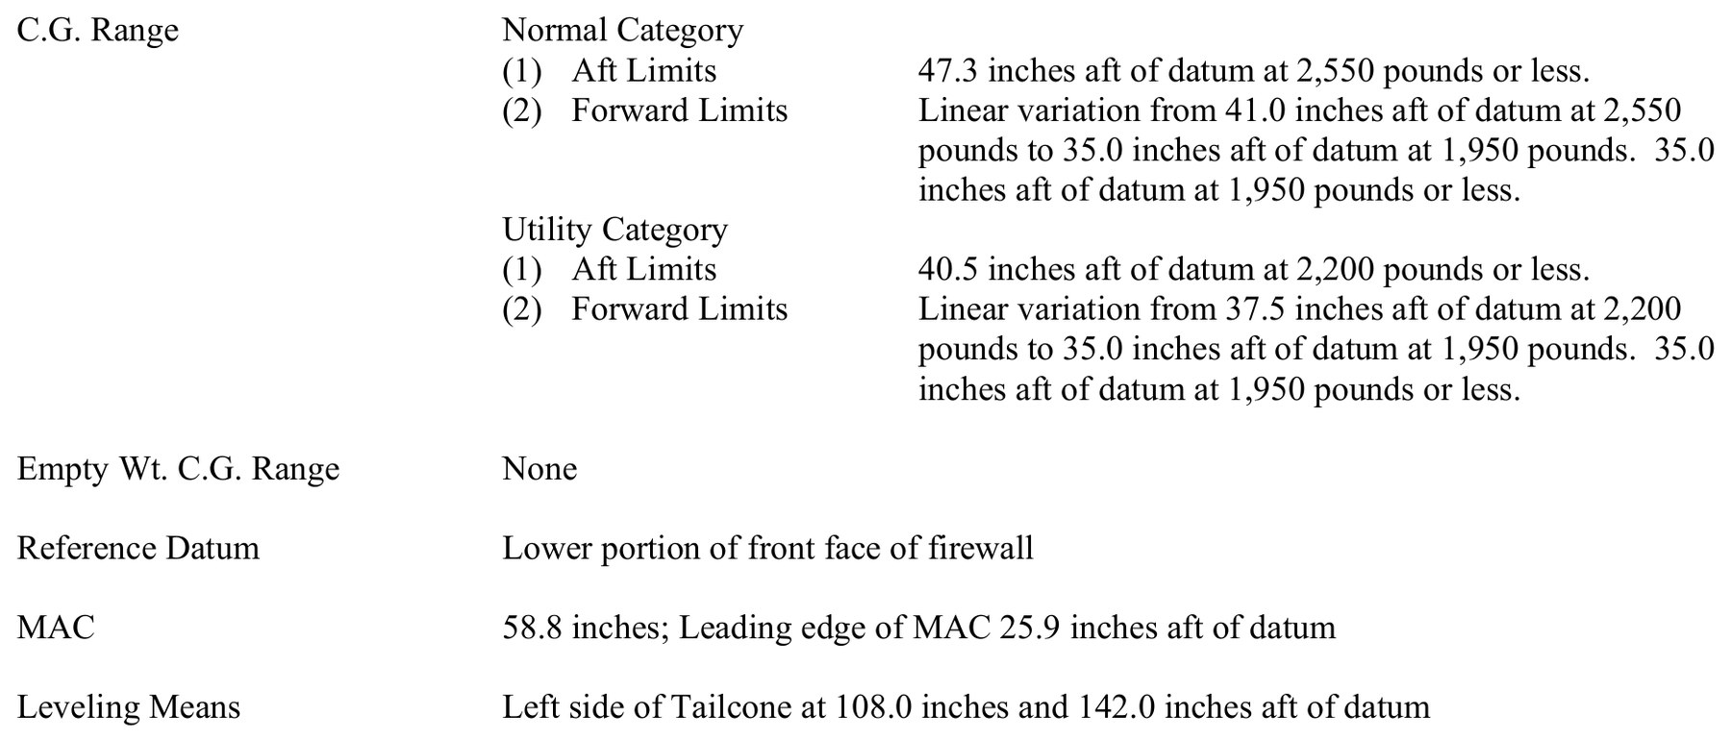
AI.II.F.K3
Datum and Arm in Plain Words
Datum: the zero point
C172S: front face of firewall
Arm: inches from datum
Aft is plus, forward minus
TCDS 3A12 p30, PHAK 10-6
Notes:
Think of a tape measure hooked on the firewall. Every seat, tank, and bag has a distance on that tape. That distance is the arm.

Slide 17
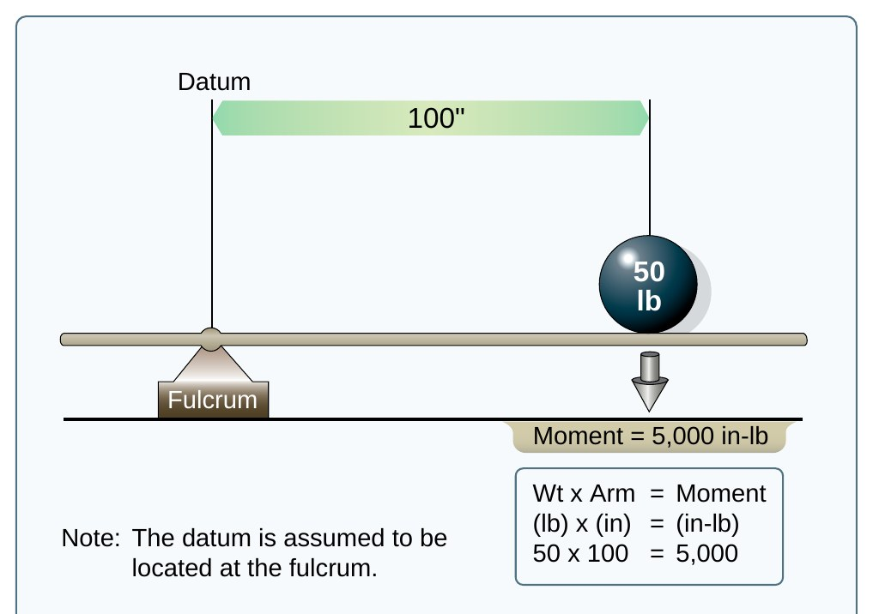
AI.II.F.K3
Definitions: Moment and CG
Moment
“the product of the weight of an item multiplied by its arm. Moments are expressed in pound-inches (in-lb). Total moment is the weight of the airplane multiplied by the distance between the datum and the CG.”
Center of gravity (CG)
“the point about which an aircraft would balance if it were possible to suspend it at that point.”
PHAK 10-4, PHAK 10-5, PHAK Fig 10-3
Notes:
Read the definitions. The CG definition in the PHAK continues, but this first sentence is the core idea.

Slide 18
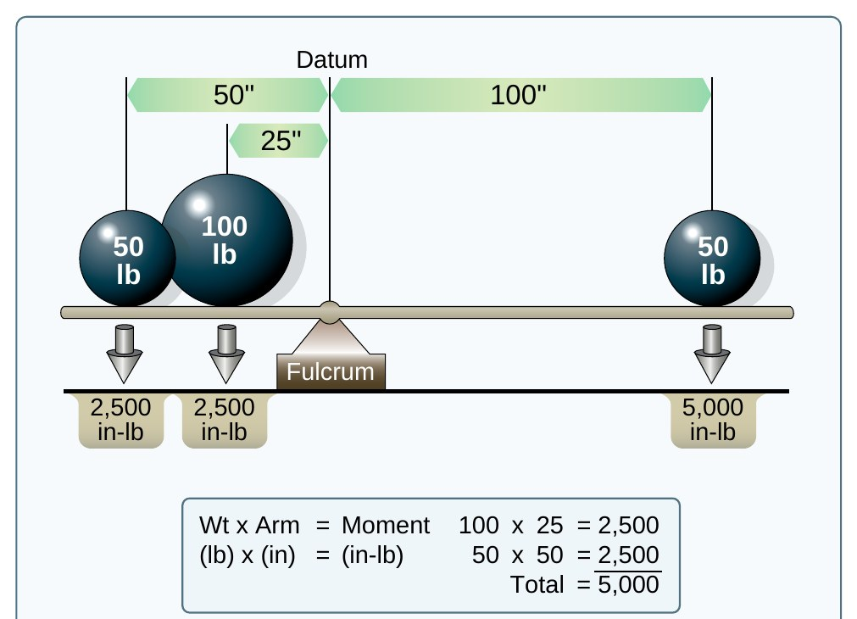
AI.II.F.K3
Moment and CG in Plain Words
Moment = weight x arm
50 lb x 100 in = 5,000
CG: the balance point
CG = total moment / weight
PHAK 10-6, PHAK 10-7, PHAK Fig 10-4
Notes:
Moment is how hard a weight tries to rotate the airplane about the datum. Heavy and far back is a big moment. CG is where it all balances.

Slide 19
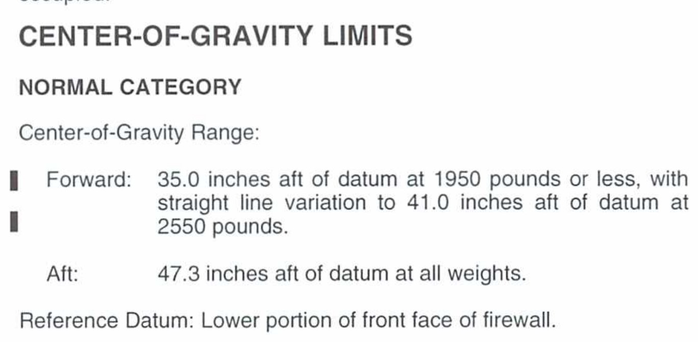
AI.II.F.K3
Definitions: CG Limits and Maximum Weight
CG limits
“the specified forward and aft points within which the CG must be located during flight. These limits are indicated on pertinent aircraft specifications.”
Maximum weight
“the maximum authorized weight of the aircraft and all of its equipment as specified in the TCDS for the aircraft.”
PHAK 10-5, POH 2-8
Notes:
The ACS says maximum gross weight. The PHAK term is maximum weight. Read both definitions word for word.

Slide 20
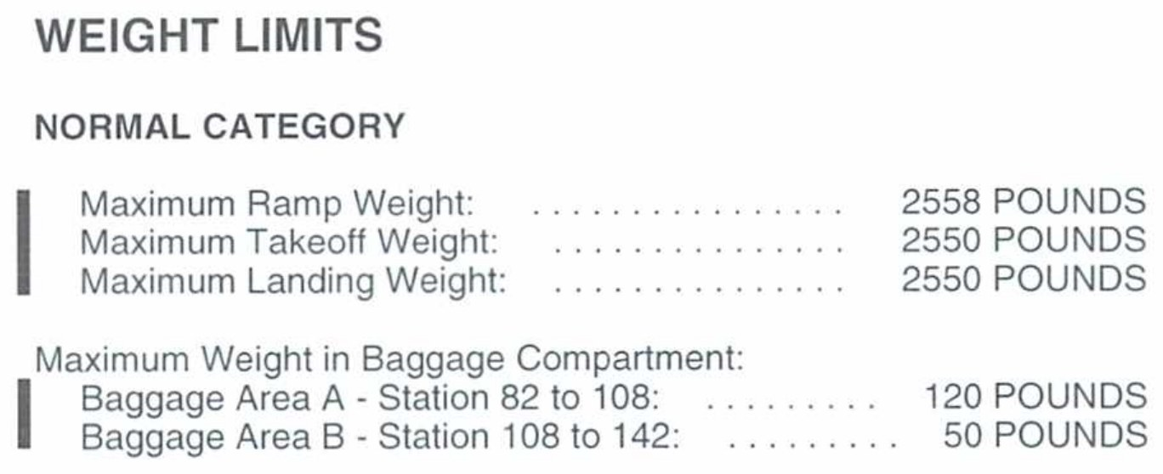
AI.II.F.K3, AI.II.F.R2
C172S Weight and CG Limits
Max takeoff and landing: 2,550 lb
Max ramp: 2,558 lb
Forward: 35.0 to 41.0 in
Aft: 47.3 in, all weights
POH 2-8, TCDS 3A12 p30
Notes:
Normal category numbers. The forward limit moves aft as weight goes up: 35.0 inches at 1,950 lb or less, straight line to 41.0 inches at 2,550 lb.

Slide 21
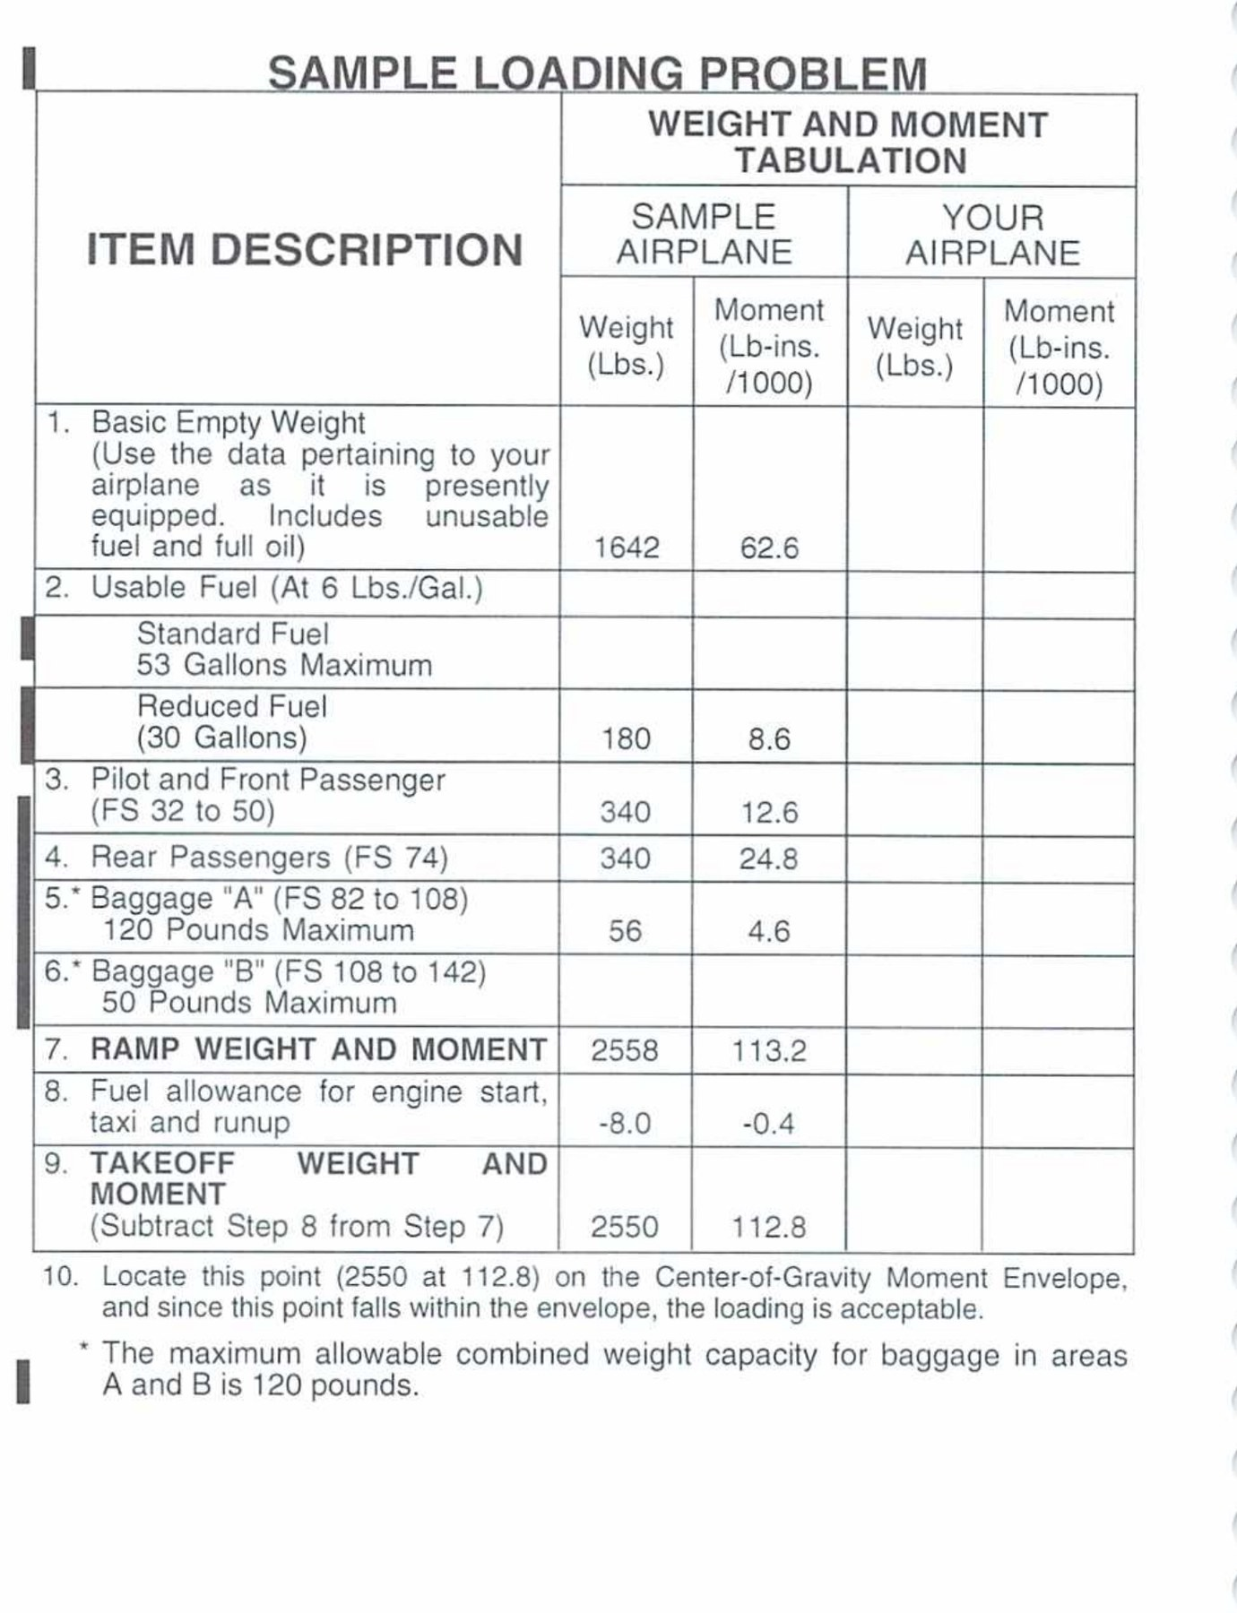
AI.II.F.K3
Definitions: Basic Empty Weight and Useful Load
Basic empty weight (GAMA)
“the standard empty weight plus the weight of optional and special equipment that have been installed.”
Useful load
“the weight of the pilot, copilot, passengers, baggage, usable fuel, and drainable oil. It is the basic empty weight subtracted from the maximum allowable gross weight.”
PHAK 10-4, PHAK 10-5, POH Fig 6-3
Notes:
Read both definitions. Then point to line 1 of the POH sample loading problem: basic empty weight.

Slide 22
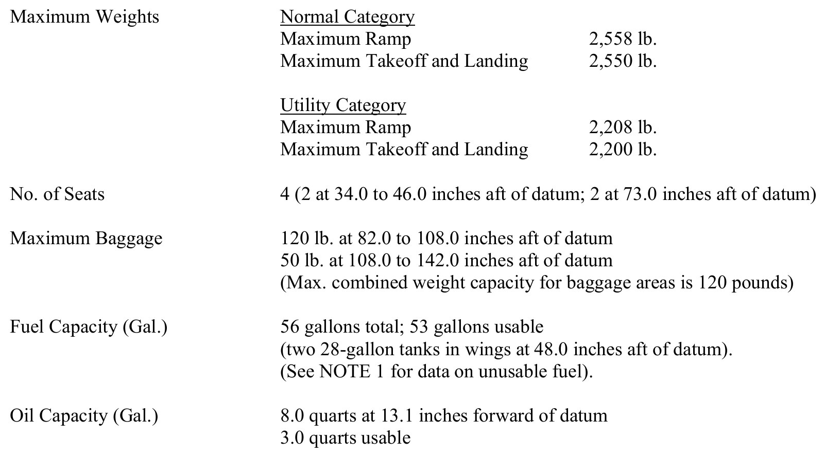
AI.II.F.K3
Empty Weight and Useful Load in Plain Words
BEW: your airplane's records
Includes unusable fuel, full oil
Useful load: max minus BEW
Sample: 2,550 minus 1,642 = 908
POH 6-10, TCDS 3A12 p30, TCDS 3A12 p32, PHAK 10-6
Notes:
Basic empty weight is the airplane with nothing we add. Useful load is what is left for people, bags, and fuel. Never use the sample number for a real flight.

Slide 23
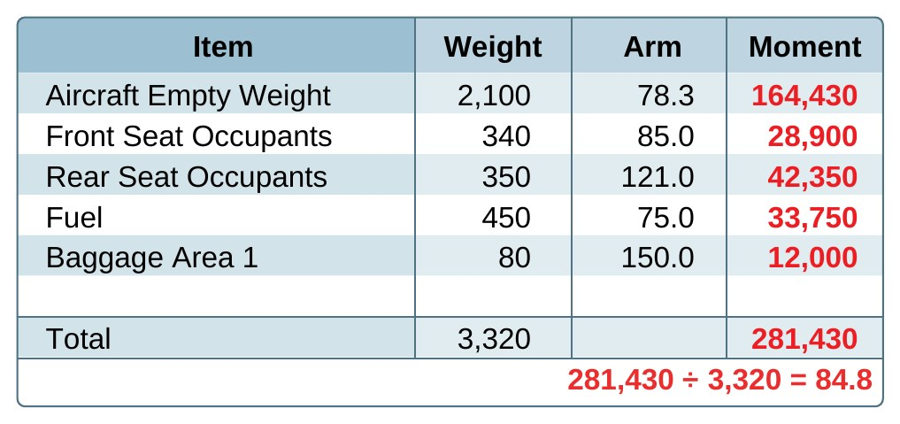
AI.II.F.K4
Three Ways to Compute CG
Computation: weight x arm
Graph: loading graph, envelope
Table: moments already figured
Same answer every way
PHAK 10-7, PHAK 10-9, PHAK Fig 10-5
Notes:
The math method is weight times arm for each item, add them up, then divide. The graph and table methods do the multiplying for you.

Slide 24
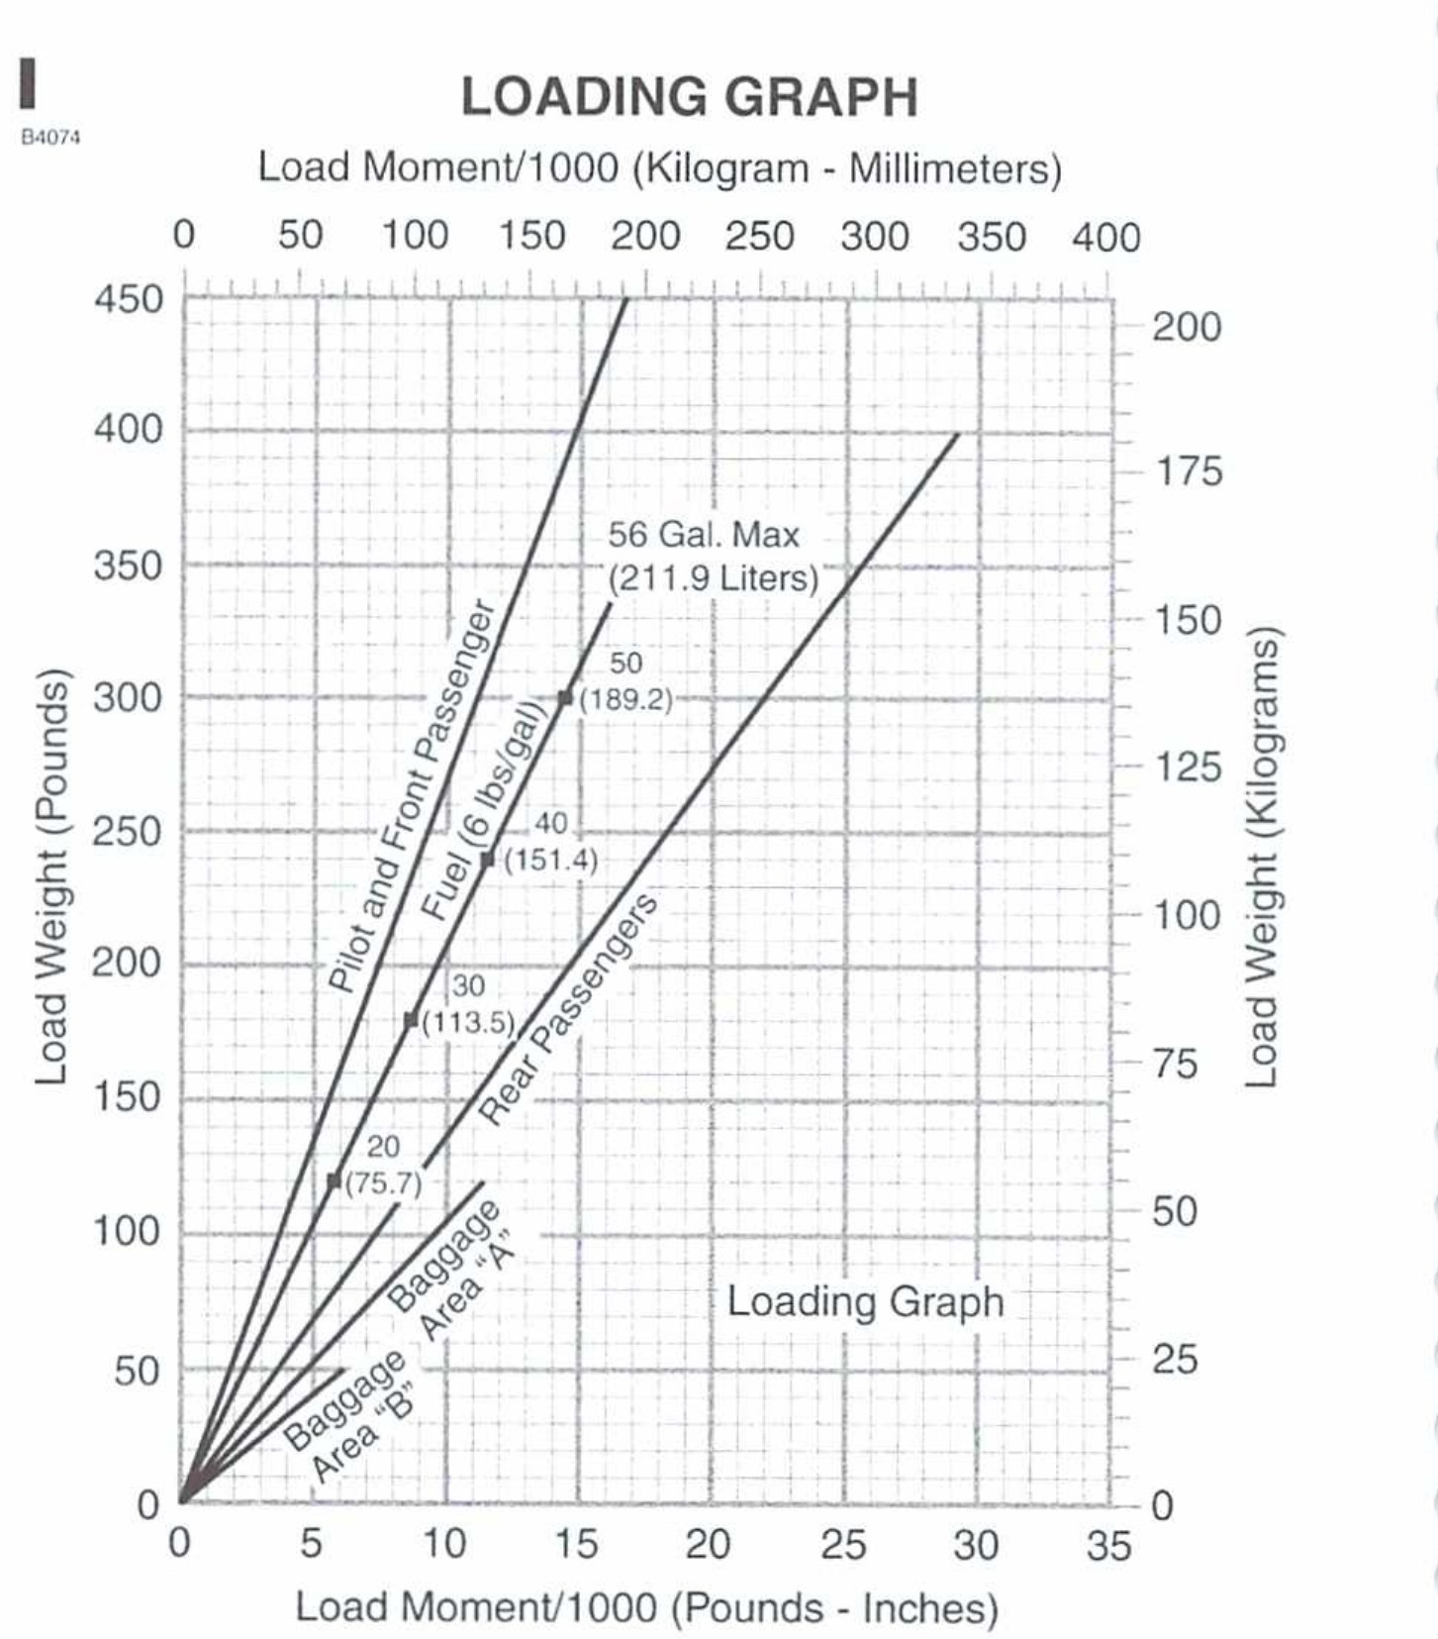
AI.II.F.K4
C172S Graph Method
Find load weight on left
Go across to the item line
Drop down: moment / 1000
Add up, then plot envelope
PHAK 10-7, POH Fig 6-4
Notes:
Find the weight on the left side, go across to the right line, then straight down to read the moment divided by 1,000. Do that for each item and add.

Slide 25
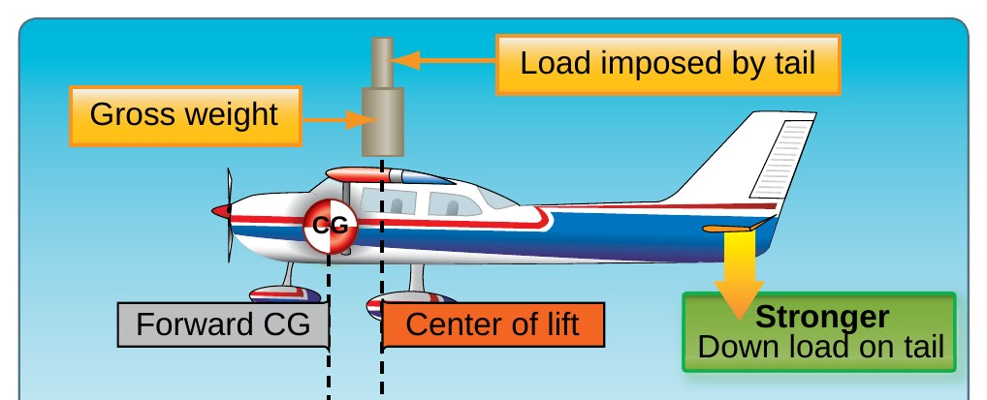
AI.II.F.K5
Aerodynamics: Forward CG
Tail pushes down harder
Higher stall speed
Heavier elevator forces
Harder to flare
PHAK 5-43, PHAK 5-44, PHAK 10-3
Notes:
With a forward CG the tail has to push down harder to hold the nose up. That adds load to the wing, so the stall speed goes up and the airplane is slower.

Slide 26
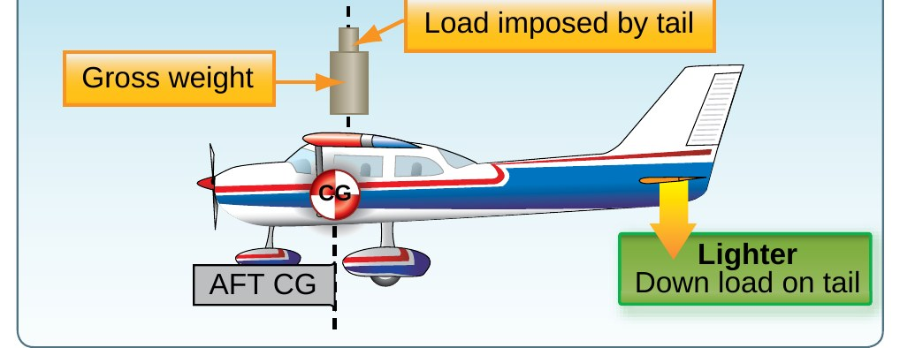
AI.II.F.K5
Aerodynamics: Aft CG
Less stable
Very light control forces
Harder stall and spin recovery
Faster cruise from less drag
PHAK 5-43, PHAK 5-44, PHAK 10-3
Notes:
Aft CG feels nice in cruise because it is a little faster. But it is less stable, the controls get light, and stall and spin recovery get harder.

Slide 27
AI.II.F.S1, AI.II.F.K1
Example: C172S Takeoff Setup
POH sample problem
Read next higher values
Item | Given
Takeoff weight | 2,550 lb
Field pressure altitude | 1,500 ft
Temperature | 28 C
Wind | 12 kt headwind
Field length | 3,500 ft
Chart row used | 2,000 ft, 30 C
POH 5-3, POH 5-4, POH Fig 5-5
Notes:
This is the POH sample problem. Field is 1,500 feet and 28 degrees, but the POH reads the chart at 2,000 feet and 30 degrees for a conservative answer.

Slide 28
AI.II.F.S1
Example: Takeoff with Wind Correction
12/9 x 10% = 13% shorter
Distance (ft) | Chart | Minus 13% | Corrected
Ground roll | 1,285 | 167 | 1,118
Over 50 ft obstacle | 2,190 | 285 | 1,905
POH 5-4, POH 5-5, POH Fig 5-5
Notes:
Chart answer at 2,000 feet and 30 degrees: 1,285 foot ground roll, 2,190 feet over the obstacle. The headwind correction takes 13 percent off.

Slide 29
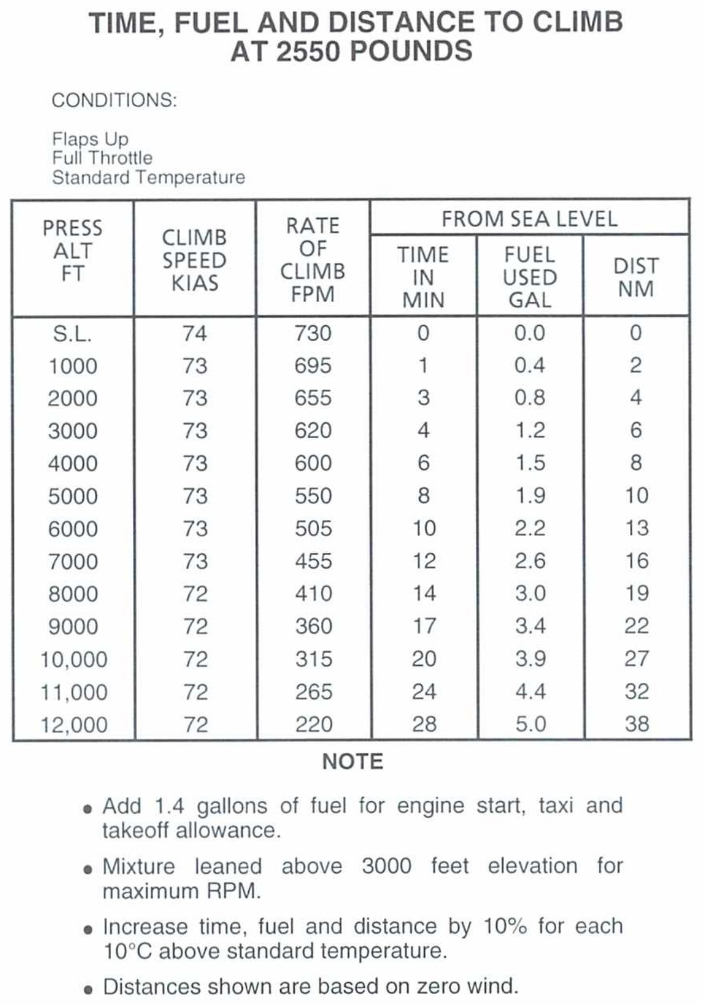
AI.II.F.S1
Example: Fuel and Distance to Climb
2,000 to 8,000 ft: 2.2 gal
Hot day: +16% (16 C)
Corrected fuel: 2.6 gal
Distance: 18 nm
POH 5-6, POH Fig 5-7
Notes:
Subtract the 2,000 foot line from the 8,000 foot line. Then add 10 percent for every 10 degrees above standard.

Slide 30
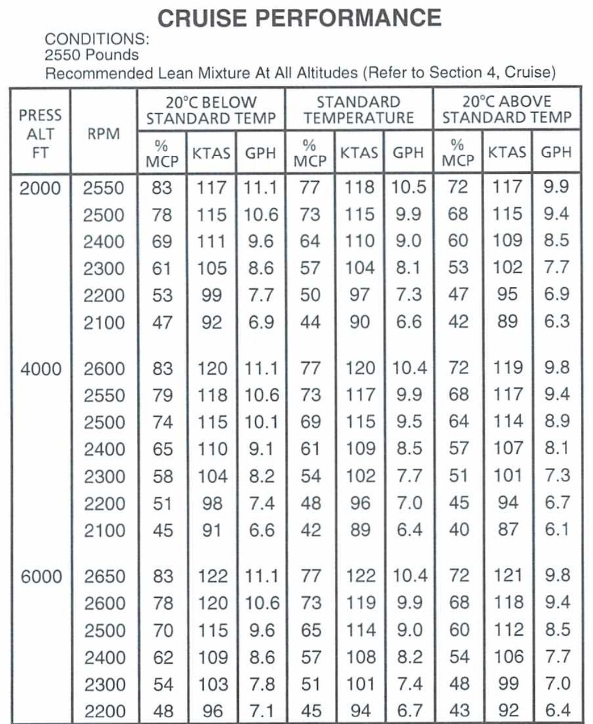
AI.II.F.S1
Example: Cruise Performance
8,000 ft, 20 C above standard
2,600 RPM: 64% power
117 KTAS at 8.9 GPH
10 kt headwind: 107 kt GS
POH 5-5, POH 5-7, POH Fig 5-8
Notes:
The POH enters the cruise chart at 8,000 feet and 20 degrees above standard, the closest match to the plan. 2,600 RPM gives 64 percent, 117 knots true, 8.9 gallons per hour.

Slide 31
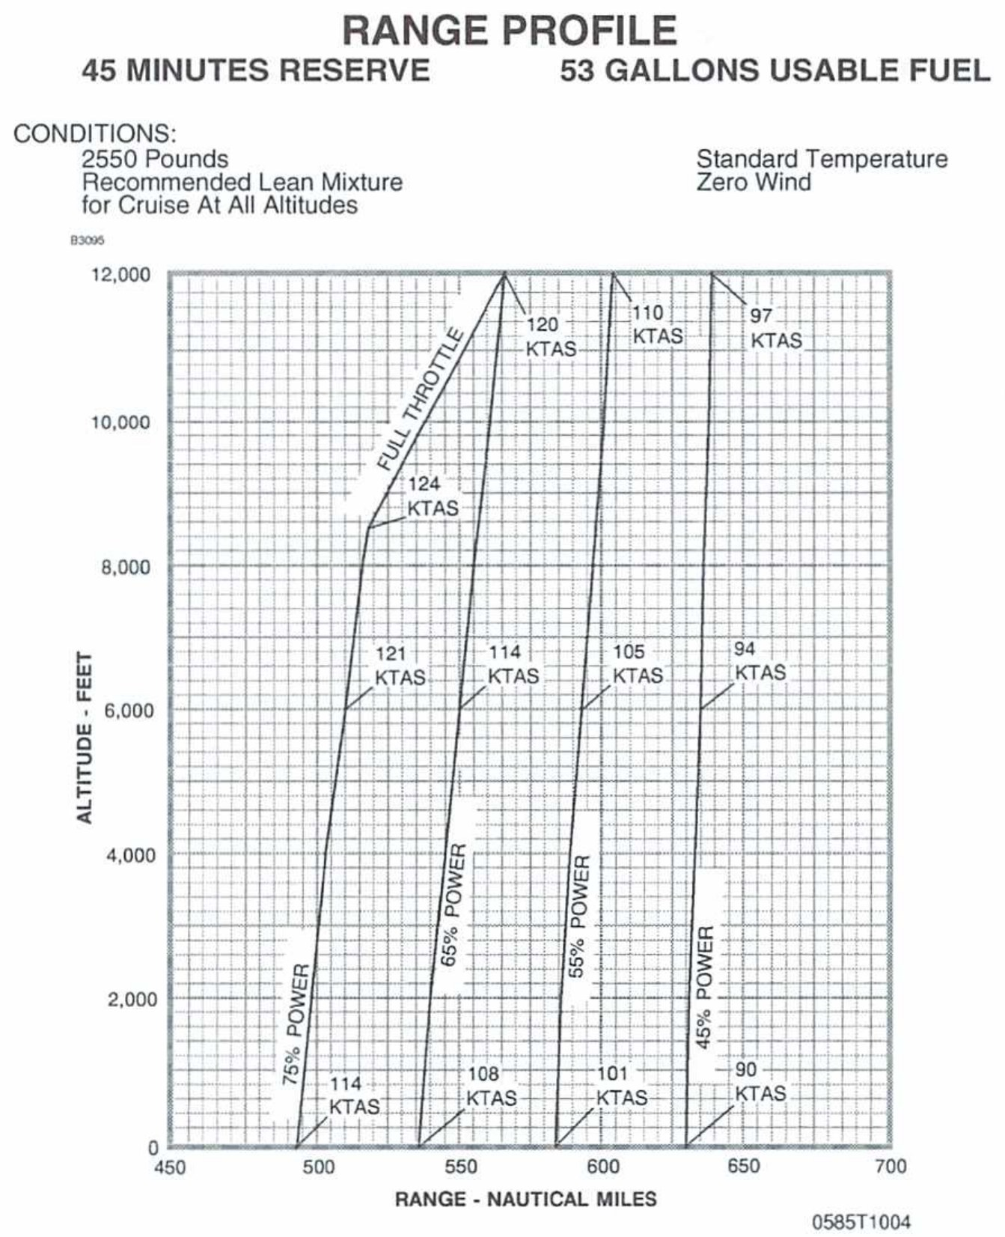
AI.II.F.S1
Example: Total Fuel Required
360 nm trip, 53 gal usable
Leg | Gallons
Start, taxi, takeoff | 1.4
Climb (18 nm) | 2.6
Cruise (342 nm, 3.2 hr) | 28.5
Reserve (45 min) | 6.7
Total required | 39.2
POH 5-6, POH 5-7, POH Fig 5-9
Notes:
This is the fuel part of a nav log. Climb distance comes off the trip, cruise time is distance over groundspeed, then add taxi fuel and a 45 minute reserve.

Slide 32
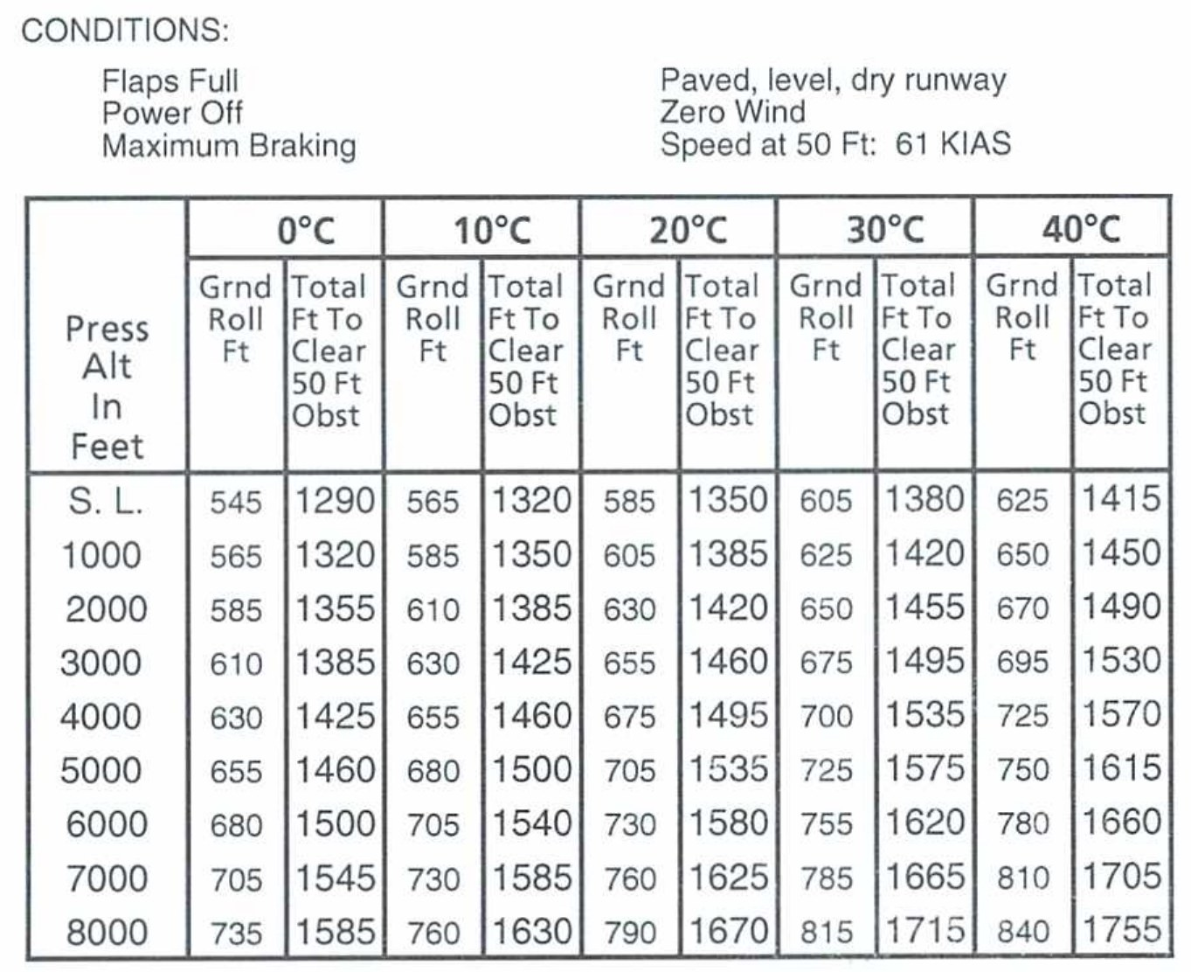
AI.II.F.S1
Example: Landing Distance
Destination: 2,000 ft, 25 C
Read at 2,000 ft, 30 C
Ground roll: 650 ft
Over 50 ft obstacle: 1,455 ft
POH 5-8, POH Fig 5-11
Notes:
Same idea as takeoff. Read the landing chart at the conservative row and column, then apply wind and surface notes.

Slide 33
AI.II.F.S2
Example: C172S Sample Loading
Item | Weight (lb) | Moment /1000
Basic empty weight | 1,642 | 62.6
Fuel (30 gal) | 180 | 8.6
Pilot and front pass. | 340 | 12.6
Rear passengers | 340 | 24.8
Baggage A | 56 | 4.6
Ramp | 2,558 | 113.2
Start and taxi fuel | -8 | -0.4
Takeoff | 2,550 | 112.8
POH 6-10, POH Fig 6-3
Notes:
This is the POH sample. Add weights, add moments, subtract the 8 pounds of taxi fuel. Takeoff weight 2,550 pounds, moment 112.8.

Slide 34
AI.II.F.S2
Example: Plot on the Envelope
Plot 2,550 lb at 112.8
Inside envelope: approved
CG: 112,800 / 2,550 = 44.2 in
Limits: 41.0 to 47.3 in
POH 6-10, POH Fig 6-7, POH 2-8
Notes:
Find 2,550 on the left, 112.8 on the bottom. The point is inside the normal category envelope, so the loading is acceptable.

Slide 35
AI.II.F.S2, AI.II.F.R6
Check Every Phase: Fuel Burn
Fuel arm: 48.0 in
Burn 15 gal (90 lb)
Phase | Weight | Moment /1000 | CG (in)
Takeoff | 2,550 | 112.8 | 44.2
Fuel burned | -90 | -4.3
Landing | 2,460 | 108.5 | 44.1
TCDS 3A12 p30, PHAK 10-11, POH 2-8, POH Fig 6-4
Notes:
Fuel sits at 48.0 inches, close to the CG, so burning it barely moves the CG. Still check landing weight and CG against the limits.

Slide 36
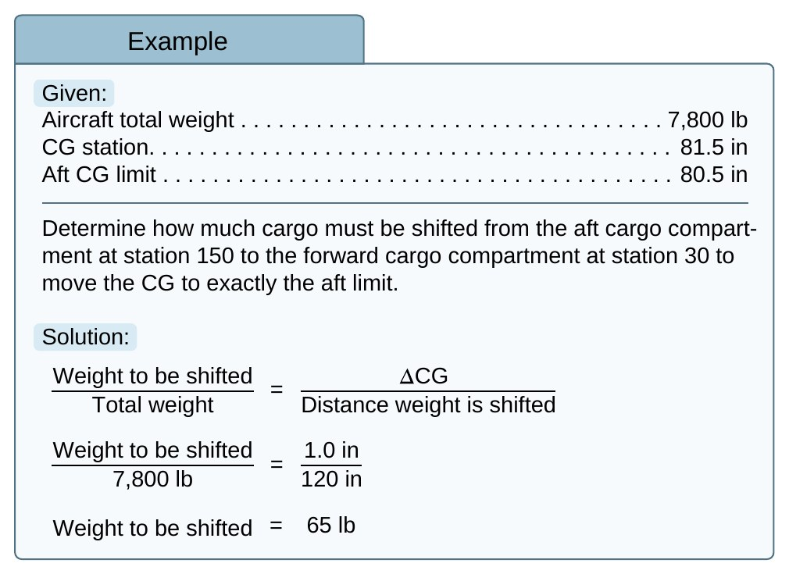
AI.II.F.S2, AI.II.F.R6
Fixing an Out-of-Limits CG
Weight moved / total weight
= CG change / distance moved
PHAK: move 65 lb forward
Recheck after every change
PHAK 10-10, PHAK 10-11
Notes:
This proportion tells us how much weight to move. In the PHAK example, moving 65 pounds forward 120 inches brings the CG 1 inch forward to the aft limit.

Slide 37
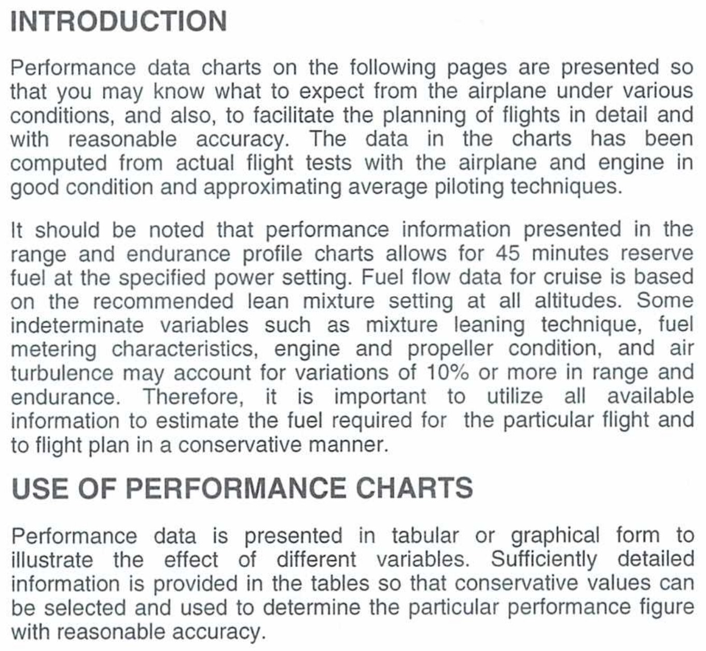
AI.II.F.R1, AI.II.F.R3
Risk: Charts vs. Real Life
Expect 10% or more variation
Use conservative chart values
Set an abort point
Scenario: hot day, short strip
POH 5-3, POH 5-4, PHAK 11-19
Notes:
Scenario: a hot afternoon, a 2,400 foot strip, full airplane. The chart says it fits with 300 feet to spare. Is that enough when the airplane is old and the grass is long? Talk through it.

Slide 38
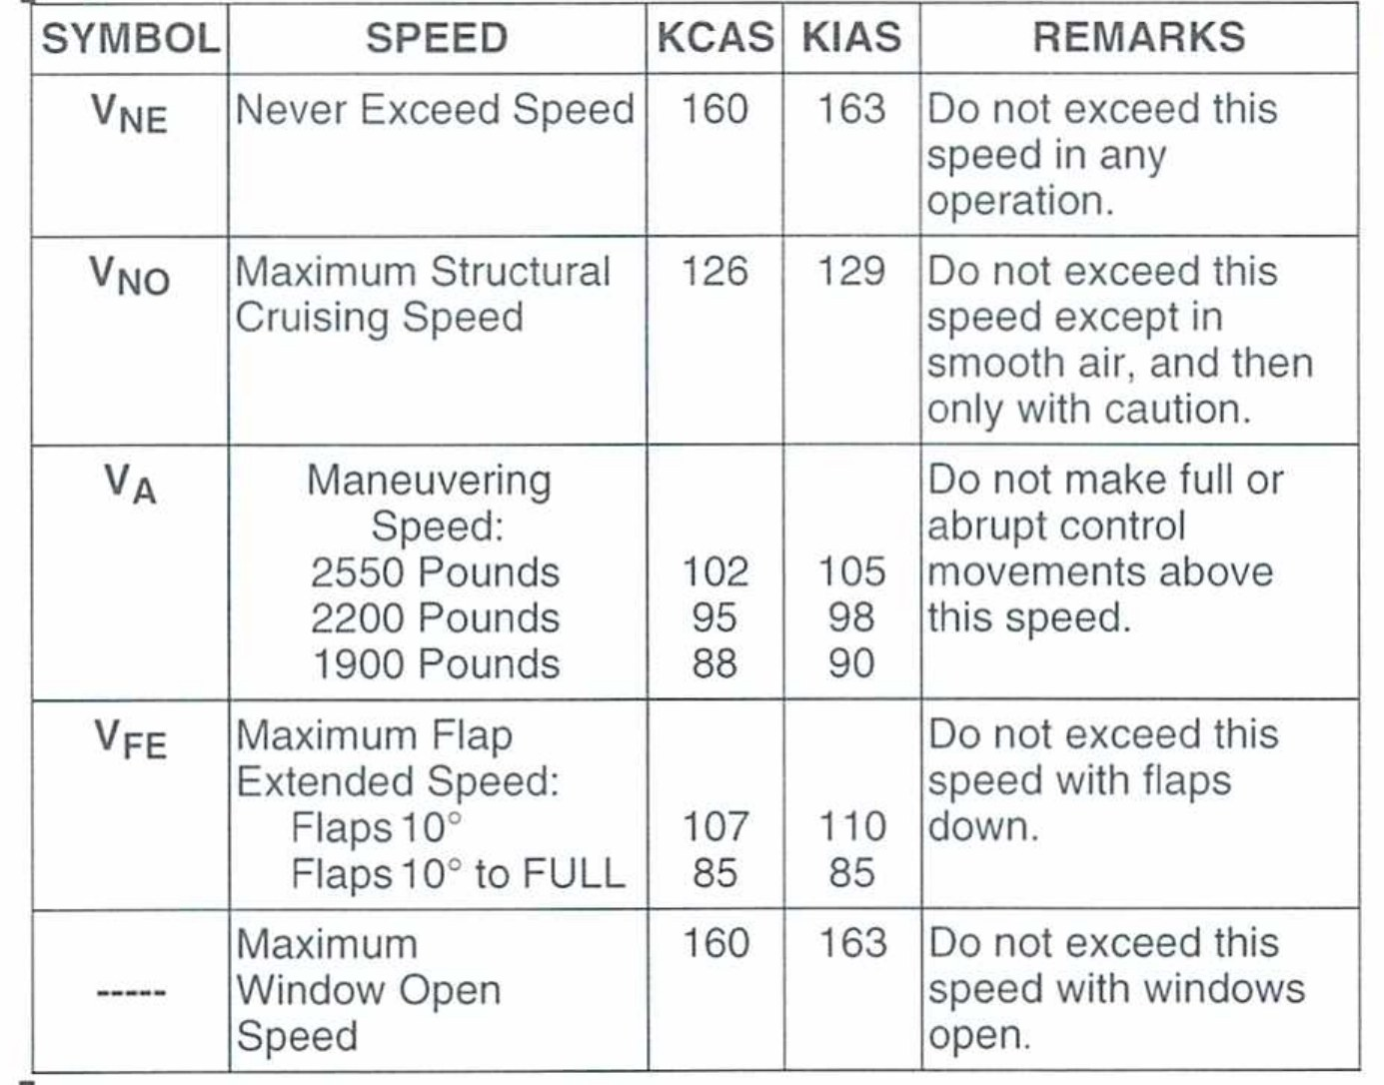
AI.II.F.R2, AI.II.F.R4
Risk: Limits and Overweight
POH limits are mandatory
Overweight: poor climb, high stall
Structure not proven above max
Scenario: four adults, full tanks
PHAK 10-1, PHAK 10-2, PHAK 10-4, POH 2-4
Notes:
Limits are not suggestions. 14 CFR 91.9 requires us to follow the AFM limits. An overweight airplane climbs poorly, stalls faster, and may be overstressed.

Slide 39
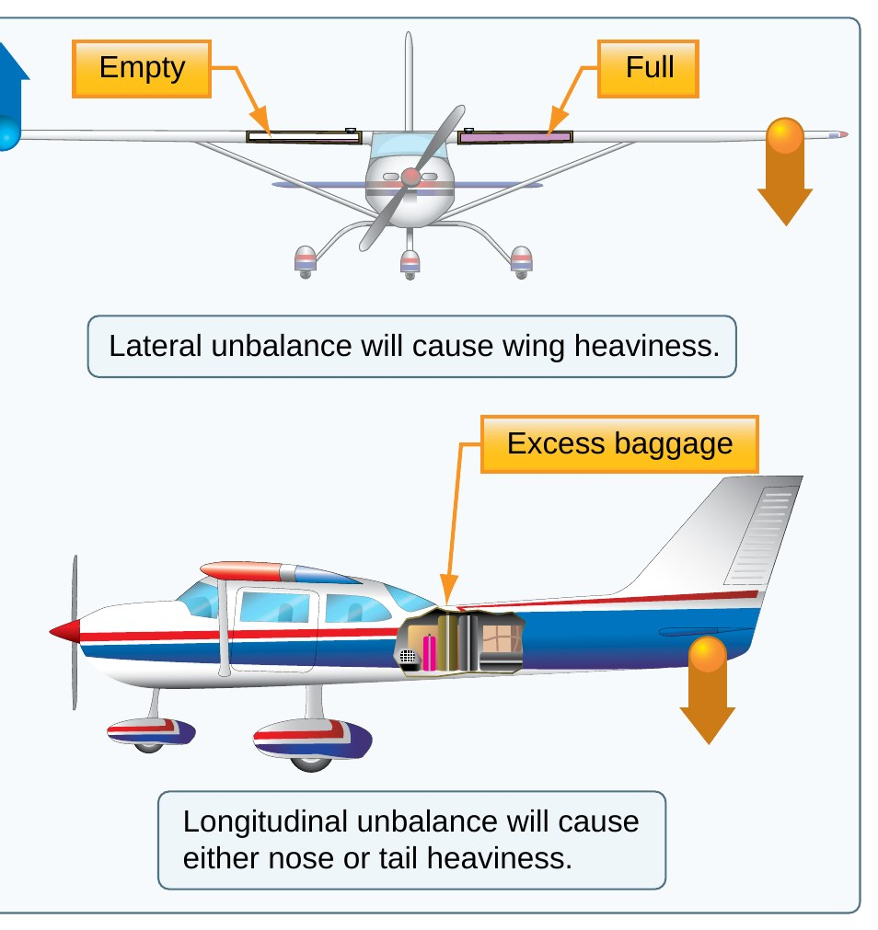
AI.II.F.R5, AI.II.F.R6
Risk: CG Limits and Shifting Weight
Out of CG: control trouble
Aft CG: stall and spin danger
Moved bags move the CG
Scenario: heavy bags in back
PHAK 10-1, PHAK 10-3, PHAK 10-11, POH 2-8, PHAK Fig 10-1
Notes:
Scenario: a passenger moves a heavy bag to the back after you did the math. Every change in loading means a new calculation.

Slide 40
AI.II.F.S1, AI.II.F.S2
Common Errors
Using the sample empty weight
Skipping the chart notes
No temperature correction
Forgetting taxi fuel
PHAK 10-6, POH 5-4, POH 5-6, POH 6-10, POH Fig 5-5, POH Fig 5-7
Notes:
These are the mistakes I see the most. Each one is fixed by slowing down and reading the whole chart.

Slide 41
AI.II.F
Review Questions
What raises density altitude?
Where is the C172S datum?
How do you find CG?
18 kt headwind: what change?
PHAK 11-2, PHAK 10-7, TCDS 3A12 p30, POH Fig 5-5
Notes:
Answers: heat, altitude, and humidity. The lower front face of the firewall. Total moment divided by total weight. About 20 percent shorter.

Slide 42
AI.II.F
References
FAA-S-ACS-25, Task II.F
PHAK Ch 5, 10, 11
C172S POH Sec 2, 5, 6
TCDS 3A12 Rev 89
See lesson plan for full reference list
Notes:
All numbers came from these sources. The C172S pages are from a training copy. Always use the POH for the airplane you fly.

